Slide 1
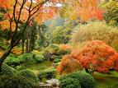
Japan is a country that has a very long history. It is not a large country only 374,744 km 2 but has a population of almost 130 million people. Today it is a very modern country producing most of the technology that the world uses. But some Japanese are still very traditional and follow the old ways. Sadly the Japanese were involved in ww2 and because of that the Americans dropped atomic bombs. But the country has recovered from that time. Today Japan is a modern technology country that still keeps many of its traditions.
JAPAN
From ancient to modern

Slide 2
Land And population
Japan consists of over 6,000 islands but the four main islands are Honshu, Hokkaido, Kyushu and Shikoku. Most of the almost 130 million people live in or around these cities. People that live in the cities mainly work in the technology industries and alot of the people that on tho coast fish for a living and it also helps keep food on the table. Outside of the cities that are filled with tall buildings the rest of Japan is lush and emerald green.

Slide 3
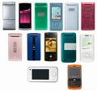
Technology
The Japanese are clever inventors they make cars, planes, computers, phones, robots and many other things. There are many well known companies that come from there such as canon, Casio, Fuji, Mitsubishi and Toyota. Japanese technology has improved and helped the modern world. Japan was one of the first countries to create robots. They also invented the bullet train, about 10 million passangers a year are carried by the bullet train. They also have about 60 airports.

Slide 4
Traditions
Japan has many traditions because it is a very ancient country. They have many different festivals and rituals. That includes Japanese new year, Seijin no hi, Sacred cherry blossoms and The Hina matsuri. Interesting traditions include beautiful geisha girls, masked entertainers ninjas (the stealthy assassins of the night) and the bold brave samurai, guardians of the land.

Slide 5
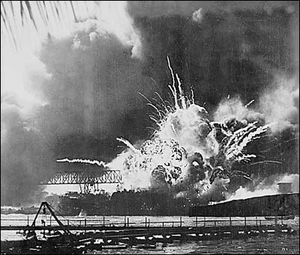
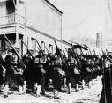
War
In it’s time Japan has had it’s fair share of wars with the worst being it’s involvement in ww2. The involvement of Japan included their bombing of pearl harbour and Darwin. To stop the war America bombed Hiroshima and Nagasaki with atomic bombs. Things have settled down since then and most of the world see’s Japan as a valuable ally.

Slide 6
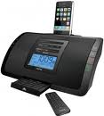
Modern Japan
Before ww2 Japan was not a very modern country but since ww2 the world is quite fond of Japan because some of the worlds best technology comes from there. They build our cars, cameras, computers, watches, phones and even robots.

Slide 7
Concluding statement
Japan has come along way in the last 100 years. It has gone from a very traditional country that didn’t have much to do with the outside world, To a world leader in technology

