Slide 1
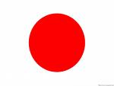
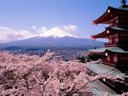
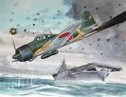
JAPAN
kamikaze
Cherry blossoms
BY:JIMMY DAM
Japanese ocean with boats
Sadako statue

Slide 2
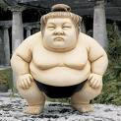
SPORT
Japan have a lot of sport like sumo
Wrestling which is a traditional sport and snow boarding which is not.Sumo wrestling
Is when two people try and push each other out of a ring or take each other down so they can win.

Slide 3
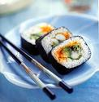
FOOD
Japan has many foods. For break fast people usually eat miso soup and rice also known as gohan in Japanese, that is usually eaten with chopstick, Japanese people usually use chopstick for every thing.But you can’t forget the Japanese food sushi.This is a little poem i wrote,wraped gracefully.filled with rice.Yummy inside.It’s sushi!

Slide 4
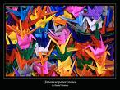
JAPANESE ART AND CRAFT
There a lot of different types of Japanese art and craft like crane with a lot of people make and traditional paintings.

Slide 5
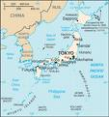
LOCATION
JAPAN
TOKYO
Japan is very small.It is located just apart from China,korea and Russia.

Slide 6
JAPANESE GEOGRAPHY
JAPAN has several thousand of islands,Honshu,Hokkaido,
Kyushu and Shikoku.

Slide 7
RELIGION
In Japan there are two main religions Shinto and Buddhism.

Slide 8
POPULATION
Japan is small but full of people Japan’s population is a huge number it is 128,000,000.

Slide 9
MONEY
JAPAN’s currency is yen.

Slide 10
LAGUAGE
Most Japanese people speak Japanese.

Slide 11
FAMOUS PEOPLE
Japan has a lot of famous people perhaps like Jackie Chan

Slide 12
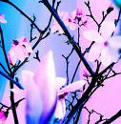
JAPANESE PLANTS
Japan has lots of trees and flowers like the petty cherry blossom. Japanese flowers are very hard to find in different places like Australia.

Slide 13
JAPANESE SYMBOLS
JAPAN has one of the most symbols in the world. Nearly every thing in Japan is a symbols like Spring which means beginning.

Slide 14
FUNFACTS
Did you know that Japanese capital is Tokyo.Japan has three different way to write,Kanji,Hiragana and Katakana

Slide 15
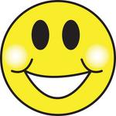
THE END
Thank you for looking at my project.

